Slide 1
Stream API
Java 8 introduces Stream

Slide 2
Stream API is used to process collections of objects.
Streams are designed to be efficient and can support improving your program’s performance by allowing you to avoid unnecessary loops and iterations.
Streams can be used for filtering, collecting, printing, and converting from one data structure to another, etc.

Slide 3
Note:
If we want to represent a group of objects as a single entity then we should go for collection.
But if we want to process objects from the collection then we should go for streams.
If we want to use the concept of streams then stream() is the method to be used. Stream is available as an interface.
Syntax:
Stream s = c.stream();
‘c’ refers to the collection.

Slide 4
So on the collection, we are calling the stream() method and at the same time, we are storing it as the Stream object.
Streams are present in java’s utility package named java.util.stream

Slide 5
The basic components involved in streams are--
Sequence of Elements
Source
Aggregate Operations
Pipelining
Internal iteration

Slide 6
Features of Java Stream
A stream is not a data structure instead it takes input from the Collections, Arrays, or I/O channels.
Streams don’t change the original data structure, they only provide the result as per the pipelined methods.
Each intermediate operation is lazily executed and returns a stream as a result, hence various intermediate operations can be pipelined. Terminal operations mark the end of the stream and return the result.

Slide 7
How does Stream Work Internally?
In streams,
To filter out from the objects we do have a function named filter()
To impose a condition we do have a logic of predicate which is nothing but a functional interface. Here function interface can be replaced by a random expression. Hence, we can directly impose the condition check-in our predicate.
To collect elements we will be using Collectors.toList() to collect all the required elements.
Lastly, we will store these elements in a List and display the outputs on the console.

Slide 8
// Java Program to illustrate FILTER & COLLECT Operations
import java.io.*;
import java.util.*;
import java.util.stream.*;
// Main class
public class GFG {
// Main driver method
public static void main(String[] args)
{
// Creating an ArrayList object of integer type
ArrayList<Integer> al = new ArrayList<Integer>();
// Inserting elements to ArrayList class object
// Custom input integer numbers
al.add(2);
al.add(6);
al.add(9);
al.add(4);
al.add(20);

Slide 9
// First lets print the collection
System.out.println("Printing the collection : “+ al);
// Printing new line for better output readability
System.out.println();
// Stream operations
// 1. Getting the stream from this collection
// 2. Filtering out only even elements
// 3. Collecting the required elements to List
List<Integer> ls = al.stream() .filter(i -> i % 2 == 0)
.collect(Collectors.toList());
// Print the collection after stream operation
// as stored in List object
System.out.println(
"Printing the List after stream operation : "
+ ls);
}
}

Slide 10
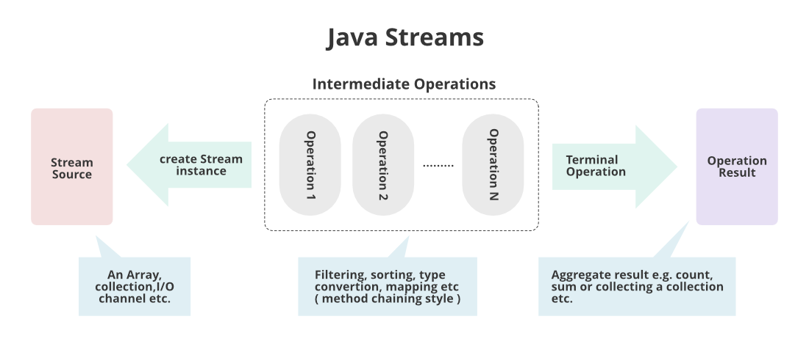

Slide 11
Various Core Operations Over Streams
There are broadly 3 types of operations that are carried over streams namely as follows as depicted from the image shown above:
Intermediate operations
Terminal operations
Short-circuit operations

Slide 12
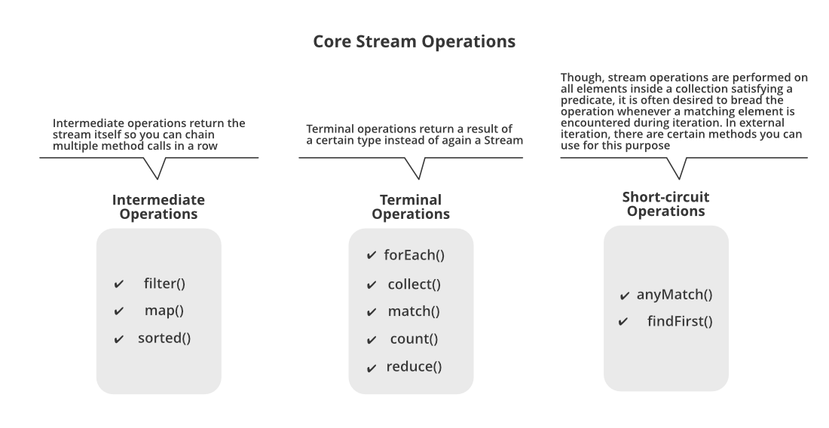

Slide 13
Lazy Evaluation
Lazy Evaluation is the concept in Java Streams where computation on the source data is only performed when the terminal operation is initiated, and source elements are consumed only as needed. It is called lazy because intermediate operations are not evaluated unless a terminal operation is invoked.
wherever the concept of the collection is applicable, stream concept can be applied there.

Slide 14
import java.util.stream.Stream;
import java.util.stream.Collectors;
public class LazyEvaluation
{
// main method
public static void main(String[] argvs)
{
Stream<Integer> strm = Stream.of(2, 4, 5, 9, 15)
.filter(y -> y % 2 == 1) // filtering the odd numbers
.peek(y -> System.out.println("Filter Done: " + y)); // displaying the message
System.out.println("Result is: ");
System.out.println(strm.collect(Collectors.toList())); // last print statement
}
}

Slide 15
Output:
Result is:
Filter Done: 5
Filter Done: 9
Filter Done: 15
[5, 9, 15]
Filter Done: 5
Filter Done: 9
Filter Done: 15
Result is:
[5, 9, 15]

Slide 16
Explanation: It is general known fact that, the first statement inside the main method executed first, and then the second statement, and after that the third statement, and so on.
However, it is not the case. The print statement that contains "Result is: " gets executed first, and the filter() and peek() methods are not executed at all. These methods get executed when the terminal operation collect() is executed in the last print statement.

Slide 17
Java Stream: Real-life Examples
Example 1:
In general, daily world, whenever the data is fetched from the database, it is more likely we will be using collection so there stream concept is must apply to deal with processed data.
Here we will be taking the most widely used namely as follows:
Streams in a Grocery store
Streams in mobile networking

Slide 18
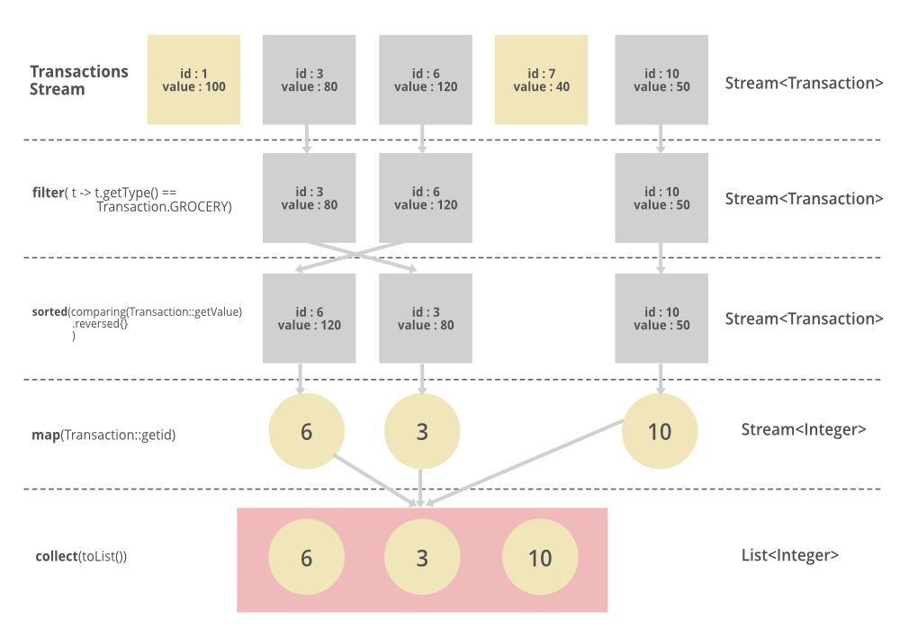

Slide 19
The above pictorial image has been provided is implemented in streams which are as follows:
List<Integer> transactionsIds = transactions.stream() .filter(t -> t.getType() == Transaction.GROCERY) .sorted(comparing(Transaction::getValue).reversed()) .map(Transaction::getId) .collect(toList());

Slide 20
What is a Pipeline?
A Stream Pipeline is a concept of chaining operations together Terminal Operations and Intermediate Operations. A Pipeline contains a stream source, which is further followed by zero or more intermediate operations, and a terminal operation.

Slide 21
Java Stream Operations
Method Types and Pipelines
Methods are of two types in Stream as mentioned below:
Terminal Operations
Intermediate Operations

Slide 22
Terminal Operations
These are the operations that after consumed can’t further be used. There are few operations mentioned below:
1. forEach
forEach performs an action for each element of the stream. Stream forEach is a terminal operation.
Syntax
void forEach(Consumer<? super T> action)

Slide 23
2. toArray
Stream toArray() returns an array containing the elements of this stream. After the terminal operation is performed, the stream pipeline is considered consumed, and can no longer be used.
Syntax
Object[] toArray()
3. min and max
min and max return the min and max elements from the stream.
Syntax
Optional<T> min(Comparator<? super T> comparator) Optional<T> max(Comparator<? super T> comparator)

Slide 24
Intermediate Operations
It returns a new stream that can be further processed. There are certain operations mentioned below:
1. filter
Stream filter returns a stream consisting of the elements of this stream that match the given predicate.
Syntax
Stream<T> filter(Predicate<? super T> predicate)
2. distinct
distinct() returns a stream consisting of distinct elements in a stream. distinct() is the method of Stream interface.
Syntax
Stream<T> distinct() Where Stream is an interface and the function returns a stream consisting of distinct elements.

Slide 25
3. Sorted
Stream sorted() returns a stream consisting of the elements of this stream, sorted according to natural order. For ordered streams, the sort method is stable but for unordered streams, no stability is guaranteed.
Syntax
Stream<T> sorted() where Stream is an interface and T is the type of stream elements.

Slide 26
Intermediate operations modify or filter the elements in the stream, and a new stream is returned. Examples: filter, distinct, map, limit, sorted.
Terminal operations generate a side effect or result, marking the end of a stream. Examples: forEach, reduce, collect, min, count, anyMatch, max, noneMatch, allMatch.
Pipelines does chain of intermediate and terminal operations, processing data in a expressive and fluent manner. Each operation receives input from the previous operation and generates output for the next operation. Pipelines allow declarative and concise coding. From the terminal operation, the result is found.

Slide 27
import java.util.*;
public class PipelineStream
{
// main method
public static void main(String argvs[])
{
// input list
List<Integer> nums = Arrays.asList(11, 12, 13, 14, 15);
int total = nums.stream().filter(y -> y % 2 != 0).map(y -> y * 2).reduce(0, Integer::sum);
System.out.println("The sum of twice of odd numbers in the input list is: " + total);
}
}

Slide 28
Comparison-Based Stream Operations
Comparison Based Stream Operations are the used for comparing, sorting, and ordering elements within a stream. There are certain examples of Comparison Based Stream Operations mentioned below:
Sorted
min and max
distinct

Slide 29
Parallel Streams
Parallel Streams are the type of streams that can perform operations concurrently on multiple threads. These Streams are meant to make use of multiple processors or cores available to speed us the processing speed. There are two methods to create parallel streams are mentioned below:
Using the parallel() method on a stream
Using parallelStream() on a Collection

Slide 30
Points to Remember About Java Streams
Streams are sequence of elements that can be processed or modified using the pipeline of operations. They are not data structures.
Streams provide support to two operations types: one is intermediate and other is terminal. Intermediate operations filter or transform the stream, while terminal operations produce a side effect or result.
The way streams are designed, make them lazy, which means processing of elements happens when there is a demand of it.

